Slide 1
Finding the Connectivity
Paht Juangphanich

Slide 2
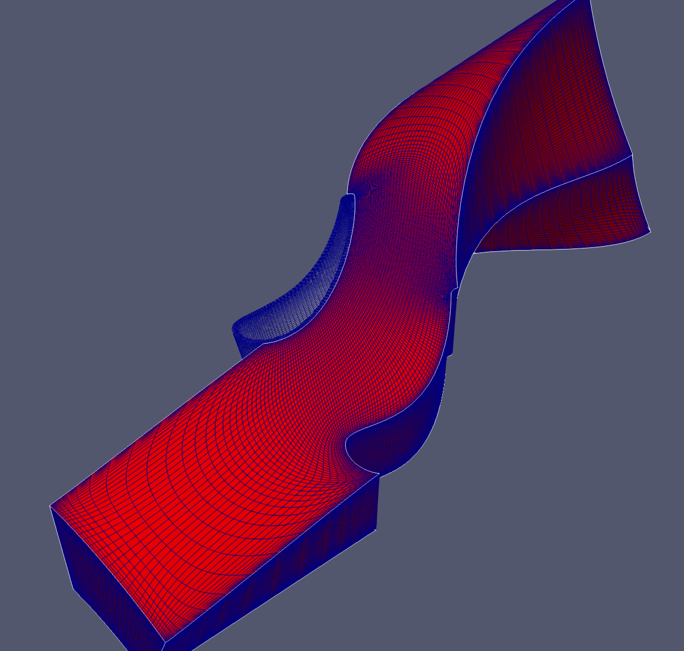
Problem
Want to couple any Plot3D Multi-block mesh to any solver requires knowledge of block connectivity
For example
O Mesh Block
H Mesh Block

Slide 3
Two-Step Solution
Extract exterior faces of each block
Compare exterior faces for matching vertices

Slide 4
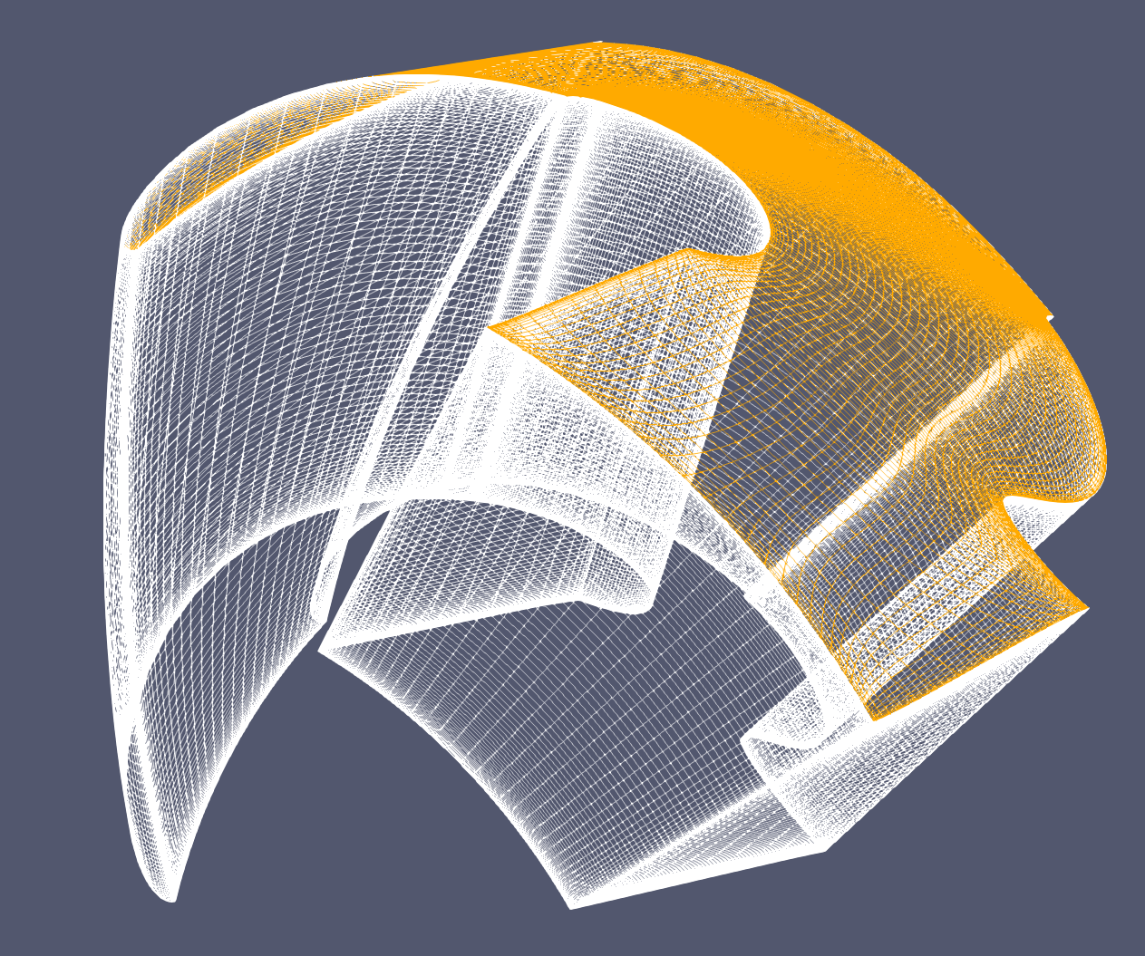
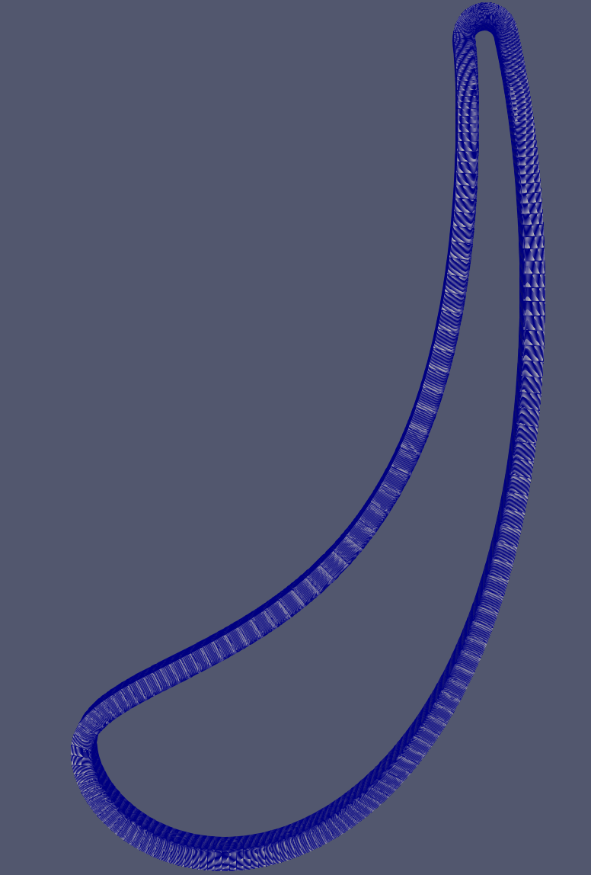
Exterior Faces
Exterior Faces occur at combinations of MAX and MIN values of I,J,K
Examples:
IMAX, JMIN, KMIN
IMIN, JMIN, KMIN
and
IMAX, JMIN, KMIN
IMIN, JMIN, KMIN
Matching Faces - OMESH
IMIN == IMAX
6 Exterior faces
4 Exterior faces

Slide 5
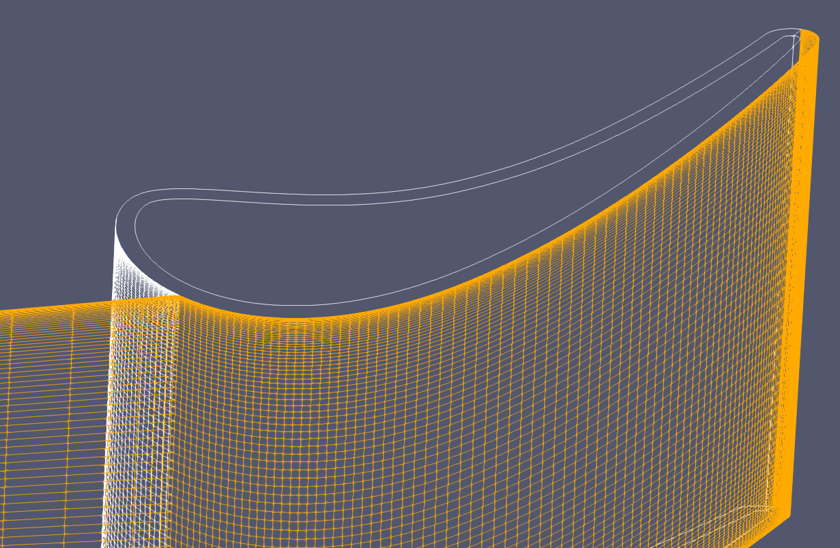
How to Find Matching Points

Slide 6
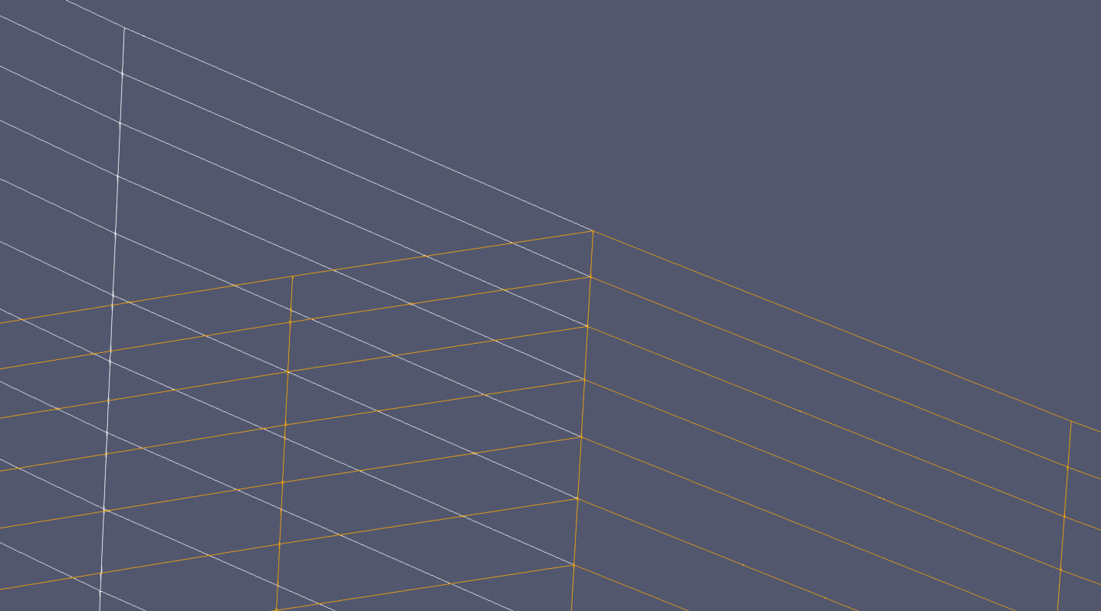
p-1, q
Check the distance for each point to see what matches
Check the edges to see if they have at least 3 connecting edges
p, q+1
p, q
p-1, q
p, q-1
p+1, q

Slide 7
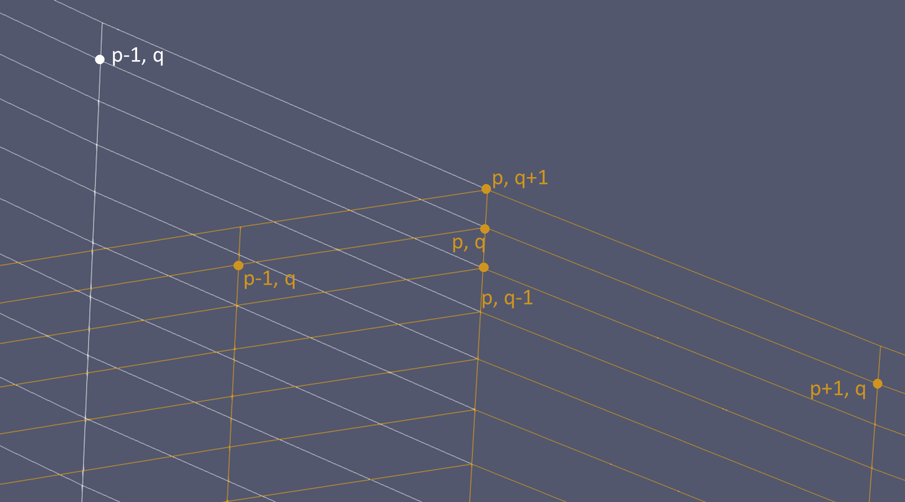
Is P increasing or decreasing
for face 1 and face 2?
Face 1
Face 2
q+1
q+1
p-1
p,q
p+1
p-1
p,q
p+1
q-1
q-1
Don’t know the direction of p or q, need to check dot product of all vector combinations

